Slide 1
Welcome to the Grade 5/6 Parent Information Evening
Teachers: Bronwyn Howell, Braden Leech and Rebecca Skinner

Slide 2
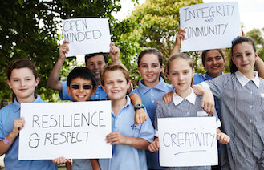
OUR SCHOOL VALUES
Our school values reflect we are a learning community where in partnership, we can learn from each other and respond to change.
At the beginning of each school year, students spend time with their teacher to discuss and define what the School Values mean.
Notes:
Address school values
Classroom Agreement

Slide 3
OUR DAY AT RPS
.

Slide 4
FLEXIBLE LEARNING SPACES
An important feature of our approach to learning at Ripponlea is the way we have designed our flexible learning spaces to create vibrant, welcoming and supportive environments that are flexible to the learning needs of our students.
Classroom layouts and furniture are designed to: - support purposeful use of classroom spaces - provide students with choice of environments - allow for collaboration and group discussions
Notes:
Orange Room
Lit Circles
Maths Groups
Shift furniture around to accommodate our needs.
Occasionally will worked together as a whole team – if we have an expert – another teacher, parent, and/or guest speaker.

Slide 5
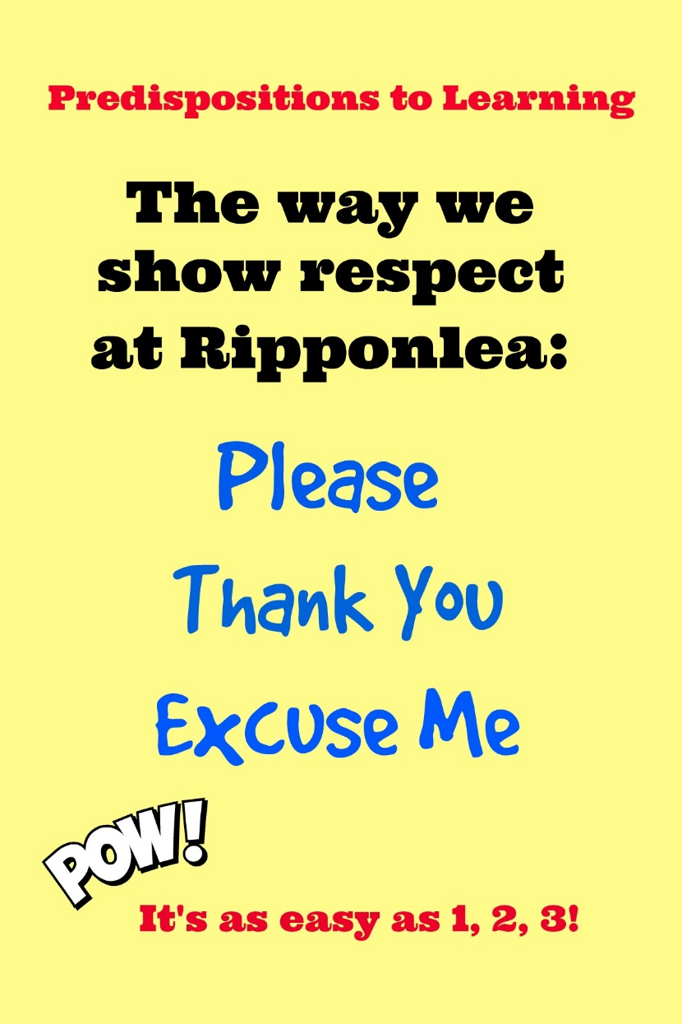
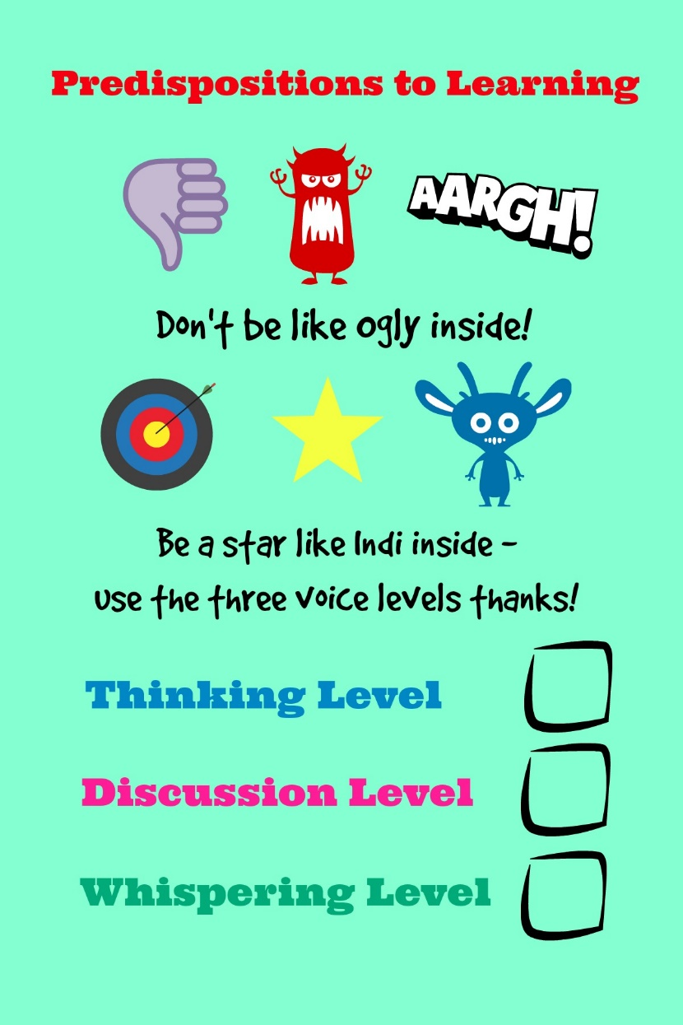
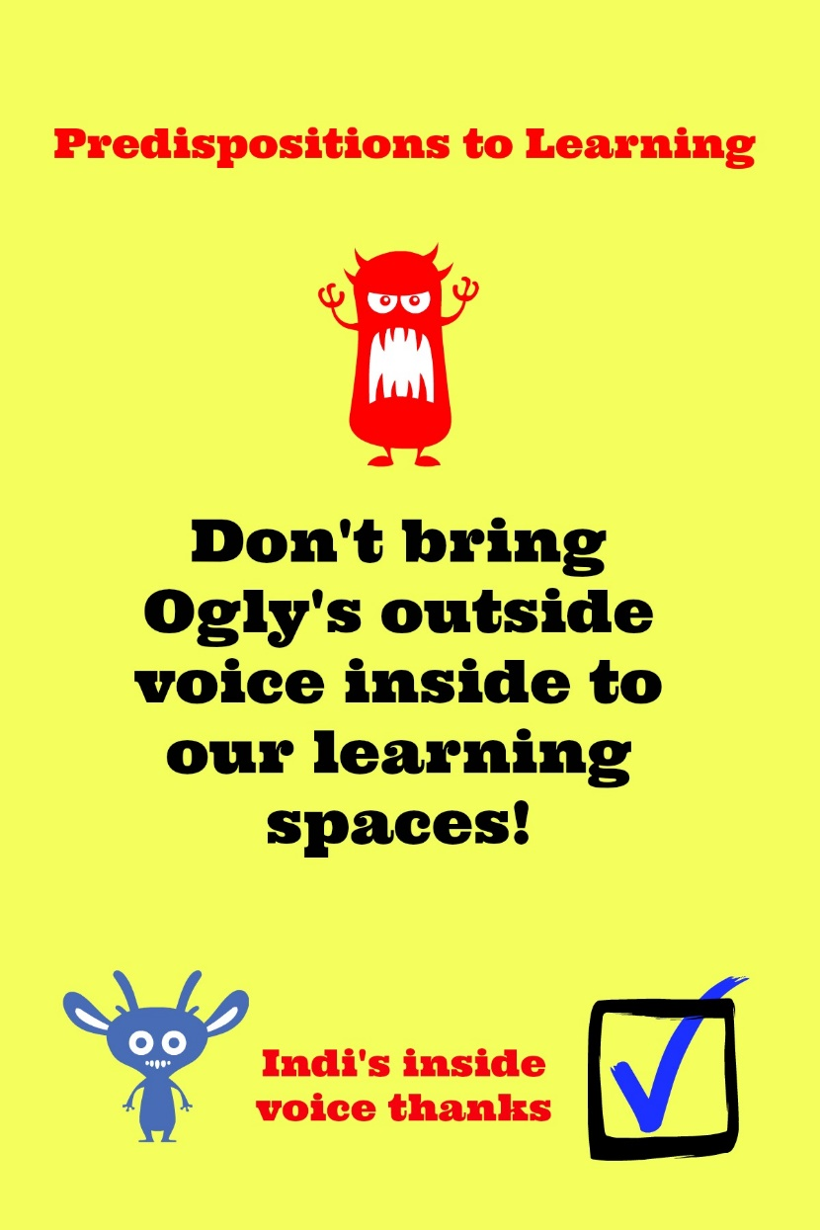
PRE-CONDITIONS TO LEARNING AND CLASSROOM EXPECTATIONS
Notes:
A new initiative regarding whole school expectations – presented to the school and we are working at whole school expetations and language surrounding them.

Slide 6
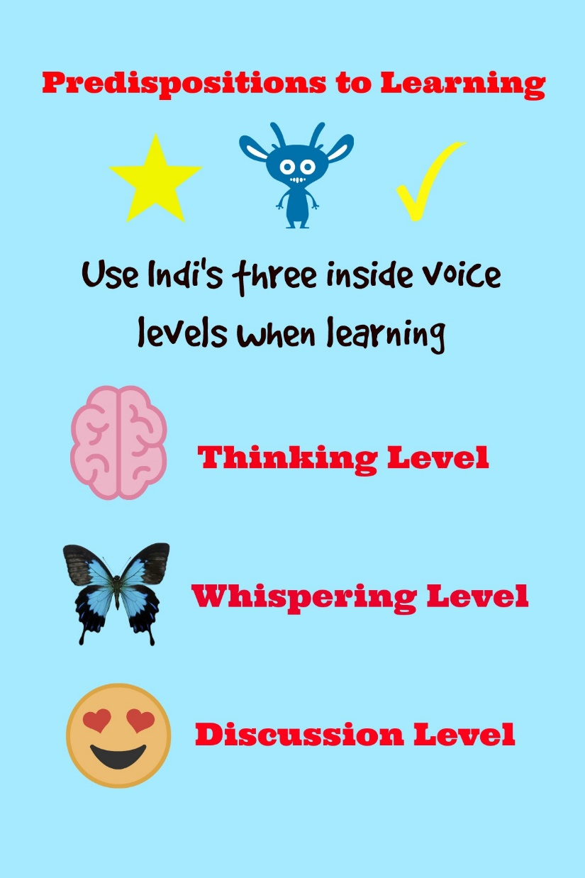
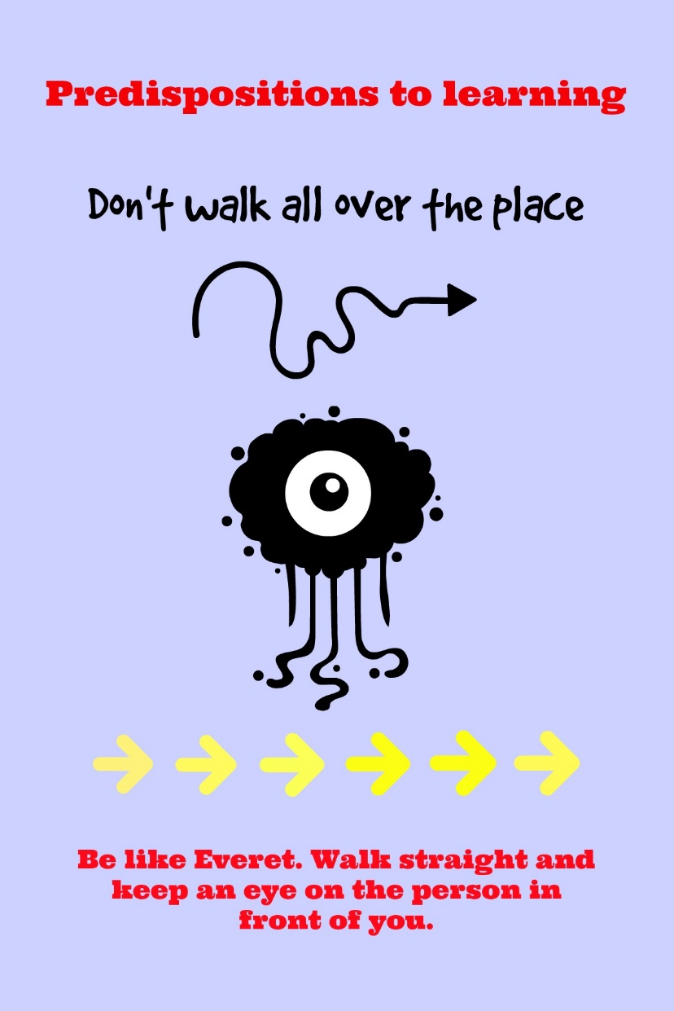
PRE-CONDITIONS TO LEARNING AND CLASSROOM EXPECTATIONS

Slide 7
TEACHING AND LEARNING
Teachers provide a stimulating, comprehensive and challenging curriculum based on the Victorian Curriculum.
Literacy and Numeracy receive the greatest time allocation within the school week.
Specialist classes are provided in:
Visual Arts
Performing Arts/Music
Languages – Italian
Physical Education Student visit their specialist classes once a week for 50 minutes

Slide 8
LEARNING INTENTIONS AND SUCCESS CRITERIA
Teachers use common vocabulary to explicitly inform students of the learning intentions and success criteria to clearly define the purpose and expectations of the activities provided. Learning intentions are written as statements to describe what the students will know, understand and be able to do as a result of their learning. Success criteria are given to help students know how and when they have achieved the learning intention.

Slide 9
RESTORATIVE PRACTICE
We use Restorative Practices to encourage engagement and build pride, respect and responsibility in each individual student. This process is used by principals and teachers as it is the basis for respectful communication, constructive relationships and how to respond to behavioural issues.

Slide 10
IN OUR CLASSROOM…
Literacy
Literature Circles
Reading comprehension tasks
Spelling
Speaking and listening
Writing
VCOP
Reading Eggs
Numeracy
Diagnostic Testing
Groups where we target the acquisition of specific understandings
Class Maths – Rich tasks where we problem solve/investigate in groups
Mathletics
Essential Assessment – Implementation, data focused, enables students to self-reflect and develop skills through “My Numeracy”
Notes:
Lit Circles – our expectations; students are reading their books at school but have permission to take home to complete. We do allow time to get their task completed at school, of course there are times when this spills over to a task at home. If you notice this is happening very regularly – please ask them why?
Maths Measurement Trail – using a ruler and a metre tape measure – measuring the side of a building. Plasticine – decimals/fractions

Slide 11
Inquiry
Inquiry
Term 1:
Adobe Suite – Photoshop, InDesign and Acrobat
Light – investigation
Living Things – structural and behavioural adaptations
Term 2:
Design and Technology: designed solution for an identified problem
Term 3:
Australian History – significant events and people
Term 4
State of Matter – solids, liquids and gasses
Notes:
Adobe Suite – Adaptations in the corridor
Expo – thanks so much
English – persuasive and advertising
Parents presenting their knowledge
Historical – as we did for the previous term
English – biographical writing and Information writing to give meaning and purpose

Slide 12
Home Learning
Literacy
Reading – 15mins a day (a fabulous switching off tool for the brain)
Discussing themes and character motivation in books and movies
Maths
If Travelling – discuss time, currency exchange, look at maps
Budgeting/manage money, mapping, converting measurements when cooking, handy/practical problem solving, time
Inquiry
Unpacking and discussing, sharing your expertise
N.B. Extension of classroom activities, that students would like to investigate further is promoted e.g. Development of a prototype

Slide 13
Extra Reminders
Attendance: If your child is to be absent or late you need to inform us ASAP. By calling the office, School Bag App, School Website. Next term: This will be able to be done via Compass (more information to come)
.
Technology Protocols: The agreement was signed at the start of the year. Simply students need to adhere to this.
Blogs: Fortnightly on the Ripponlea website.
Newsletter: Comes out Fortnightly.
Seesaw: A digital version of our Portfolio which often may include photos of class activities.
Camp:
Manyung 2018 13th – 15th August
Canberra 2019 29th April – 3rd May (second week of Term 2)

Slide 14
Thanks for coming, we appreciate your continual support.
Bron, Rebecca and Braden

